Slide 1
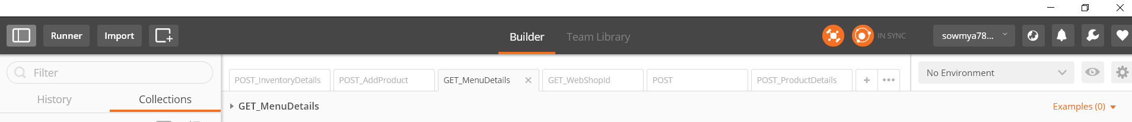
POSTMAN
Postman is a powerful HTTP client for testing web services.
It comes like a google chrome app and addon which is very useful tool for testing webservices which interacts using HTTP API’s
Implementation: first install addon on google chrome and then create an account -> you can see the user interface
Now, we have to enable postman Interceptor which is at top of the page because
Postman Interceptor helps you retrieve cookies and include cookies while sending requests. It can also send headers which are normally restricted by Chrome but are critical for testing APIs. The Interceptor makes this process painless.

Slide 2
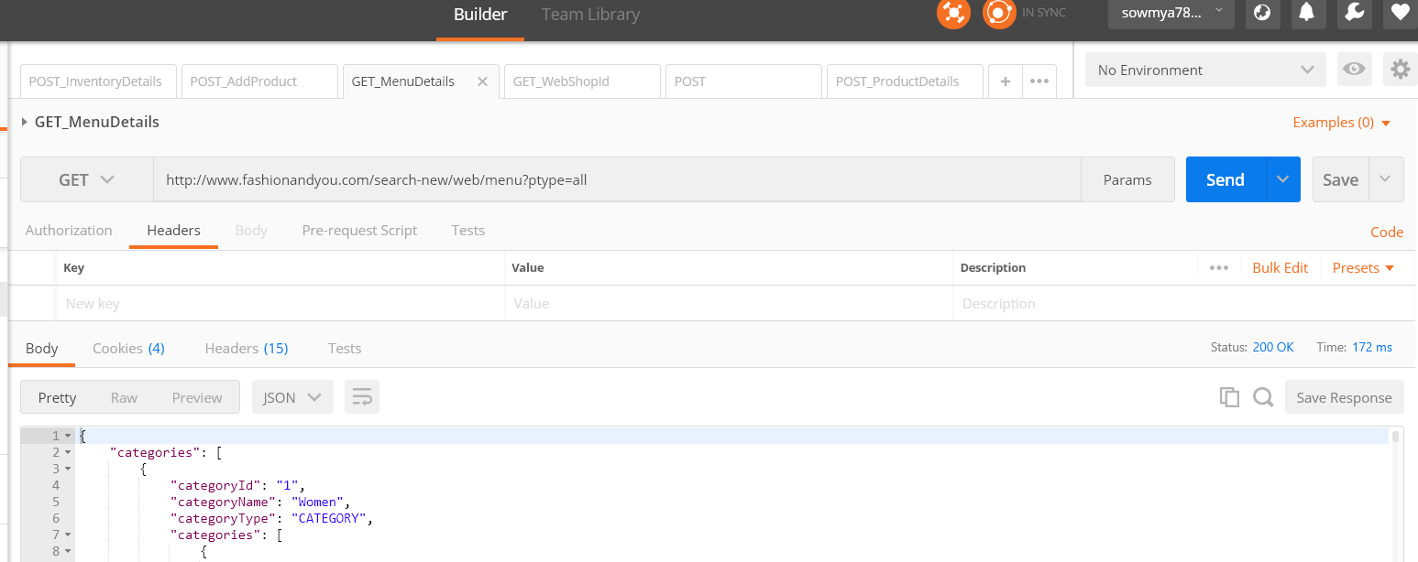
Now we have 2 things like service EndPoint and payload(request which you send in the body)
So, we have to take the endpoint from developer or manager and test it. It will be of diff types like
A) GET – to get some info based on the EndPoint
B) GET – get some info by specifying some parameters to the endpoint
C)POST – to get some details or search something based on our request which we mention in the body of our request.
Examples: GET method for getting menu details. We have supply our end point, GET from drop down and click on send.
Then we will get response along with status code -200(SUCCESS) and time

Slide 3
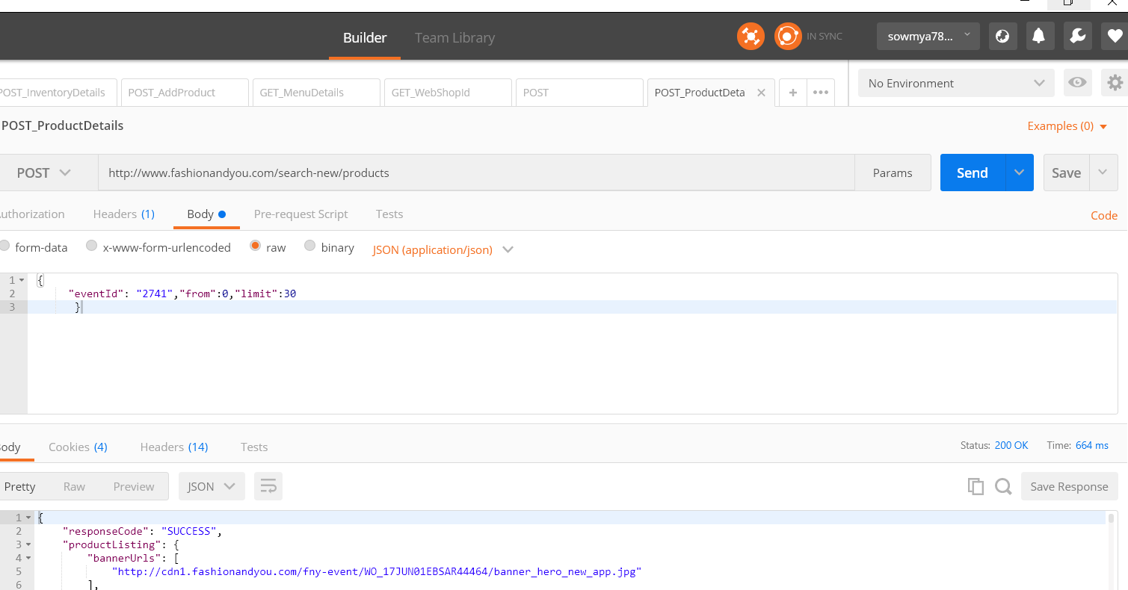
Same way we can try for POST – we have to supply end point, POST from drop down and payload which is nothing
but the body for a message (check raw button and select the type of text).
Important: here we can validate the response by writing a query in the database

Slide 4
RestAssured
It is a java library which is used to test Rest API’s. It follows a gherkin format (given, when and then)
which is a BDD style.
Given – setting cookies, setting headers, O Auth, providing/adding parameters
When – GET, POST, PUT, DELETE
Then- validating your response
Example - https://swapi.co/api/people/1
Here Base URI = https://swapi.co
Base path = /api
resource = /people/1
Important –
Response response = given().when().get("/people");
Here, get method will give you the response object

